Slide 1



SOCIAL LISTENING REPORT
Product Tracking: Nokia 7.2, Nokia 2720 Flip, Nokia 8.1, Nokia Brand
Competitor Tracking: Huawei Nova 3i, Samsung J4
Period report: 01/10/2019 – 15/10/2019

Slide 2
OBJECTIVE
Campaign : Nokia Brand & Nokia 7.2 & Nokia 2720 Flip & Nokia 8.1
Brand : HMD Nokia
Objectives : Measure the results of social media discussions about Nokia brand, Nokia 3.2, Nokia 2.2
Channels : Vietnam’s online news & social media (social networks, videos, forums, blogs, reviews sites, major e – retailers, …)
Period : October 01, 2019 – October 15, 2019
Report focus:
Volume & Engagement of Nokia Brand/ Product (in comparison week by week)
Overall Performance by channels
Sentiment Performance of Nokia Brand/ Product
Attribute Performance of Nokia Brand/ Product
Seeding Contribution
Top Content & Top Sources
Competitors Understanding

Slide 3
AGENDA
Social Insight & Recommendation
Executive Summary
Overview of Nokia 7.2, Nokia 2720 Flip, Nokia 8.1, Nokia brand
Trendline Overview
Volume of each product (In comparison week by week)
Engagement of each product (In comparison week by week)
Seeding Contribution in terms of Volume and Sentiment Redemption
Top 5 sources of positive/negative mentions
Focus on each of Nokia products (Nokia 7.2) (Nokia 2720 Flip) (Nokia 8.1)
POE Performance
Sentiment Performance
Attribute Performance
Focus on Nokia Brand
Sentiment Performance of Nokia Brand
Attribute Performance of Nokia Brand
KOL/Influencer Performance
Volume
Sentiment Performance
Competitors Overview: Huawei Nova 3i, Samsung J4
Highlight tactics

Slide 4
SOCIAL INSIGHT & RECOMMENDATION
Research & Solutions

Slide 5
SOCIAL INSIGHT & RECOMMENDATION
Social Insight | What – to – do
There were issues raised mostly by users during this period Comments on the post about Nokia 7.2 and Nokia 2720 Flip on thegioididong.com (Link, Link) These mentions mainly discussed about the function or the available of two products. A post on Facebook Page Nokia Mobile (Link) that attracted a large amount of interaction. Most, customers have good feedback on OS Upgrade or Brand (Link, Link). However, there are many negative feedbacks about Function and OS Upgrade too (Link, Link) | We should focus on the post product review and summarize strong points of product. So that, audience may have overview about product. We should focus on providing customers with practical information, experience, feedback when using the newly launched Nokia 7.2 and Nokia 2720 products to increase accessibility to customers. We should find solution for the new upgrade for OS in Nokia 8.1 to response to negative feedback of customers.

Slide 6
EXECUTIVE SUMMARY
Research & Solutions

Slide 7
EXECUTIVE SUMMARY
OVERALL BRAND VOLUME | SENTIMENT PERFORMANCE
 | WHAT MAKE UP VOLUME
 | Major mention generators were: Ecommerce (thegioididong, fptshop) Facebook (Nokia Mobile, Vật Vờ Studio, Tinh tế Fanpage) Forum (tinhte.vn) Youtube (Dương Dê, Tony Phùng Studio, ĐAM MÊ CÔNG NGHỆ) In this current period, Nokia has no minigame operation. Overall, positive mentions are about Function and Performance of Nokia 7.2, Function and Design of Nokia 2720 Flip, Function and OS_Upgrade of Nokia 8.1, and Brand and Design of Nokia Brand. Negative mentions are about Function and Hardware of Nokia 7.2, Function and Price of Nokia 2720 Flip, Function and OS_Upgrage of Nokia 8.1, and Price and Software of Nokia Brand.
EM = Exclude Minigame
IM = Include Minigame

Slide 8
PRODUCT OVERVIEW
Trendline
Volume of each products & highlight activities
Engagement of each products & highlight activities

Slide 9
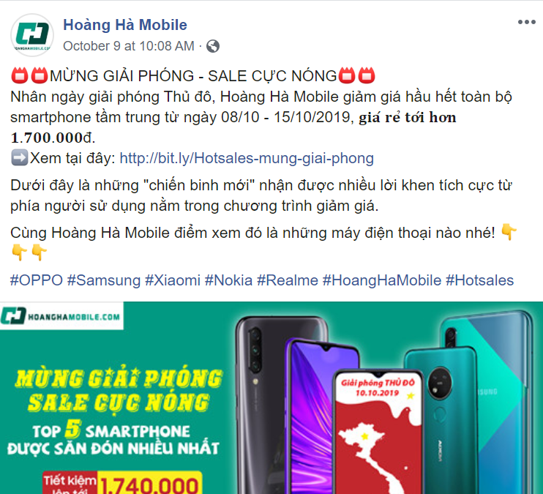

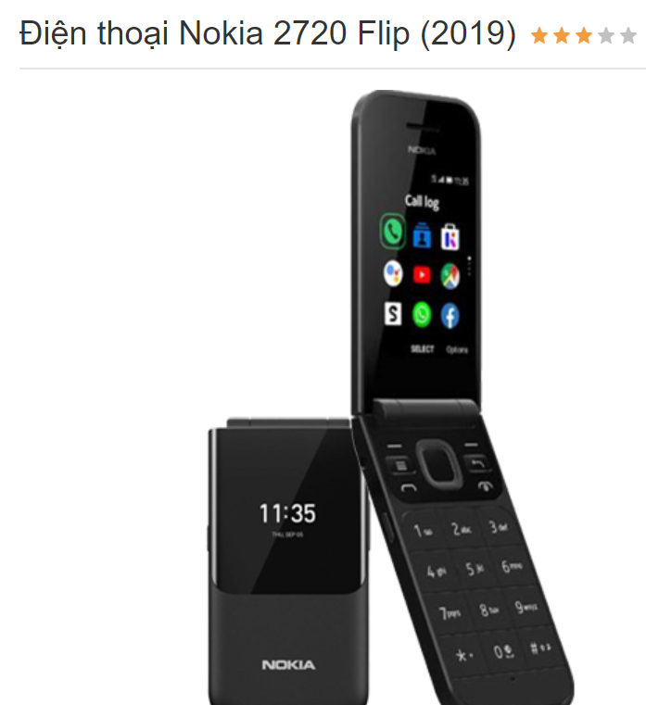
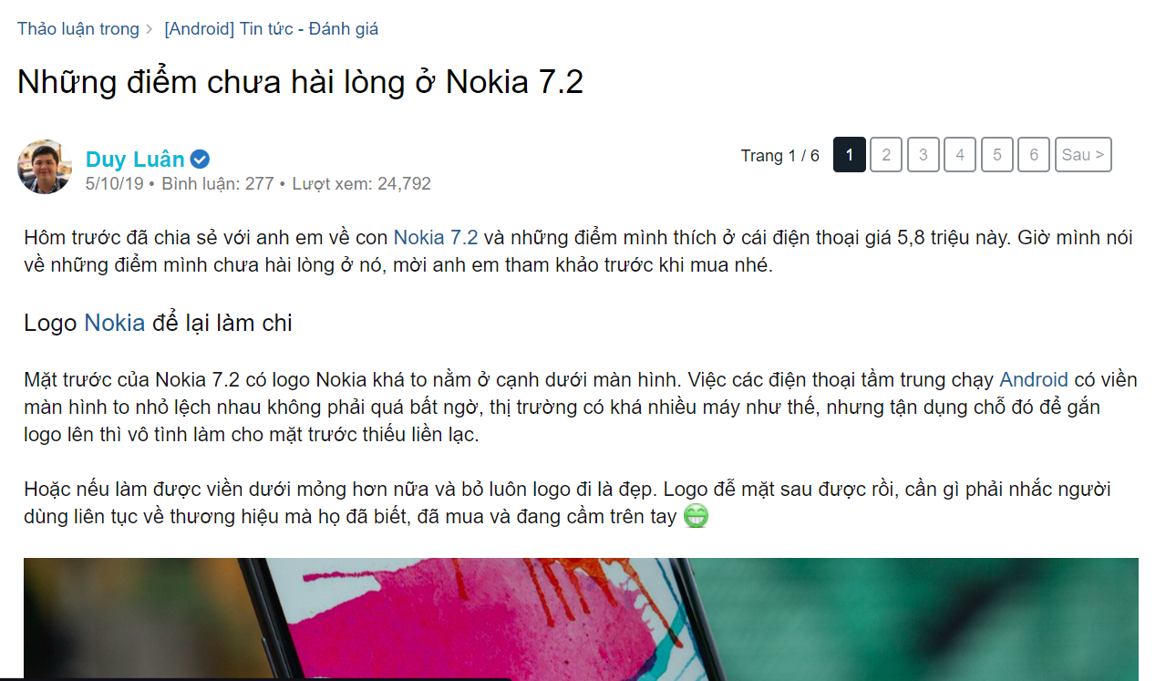
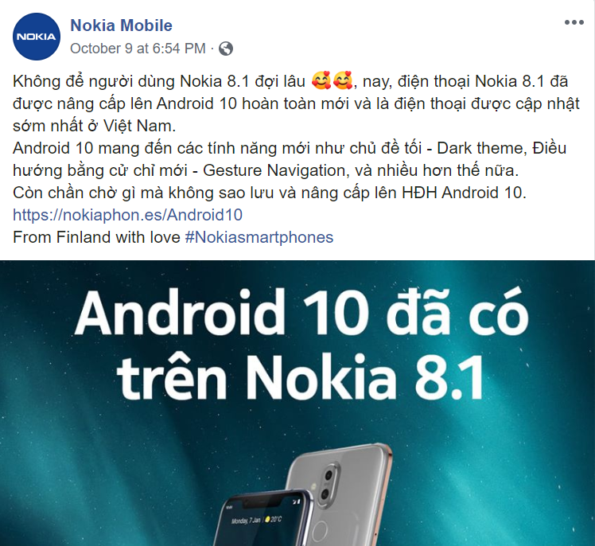
MENTION TRENDLINE
The audience more discuss about Nokia 7.2 on Oct 5th, Nokia 2720 Flip on Oct 1st, Nokia 8.1 on Oct 10th, and Nokia Brand on Oct 8th. Mostly, customers asked for product of Nokia 7.2 and discussed about the function of Nokia 2720 Flip and Nokia 8.1. Customers discussed about the function of Nokia Brand generally.
Nokia 7.2 and Nokia 2720 Flip decreased while Nokia Brand and Nokia 8.1 increased in this period, despite some fluctuation. Nokia 2720 Flip is the least discussed brand among all products.
The post that push discussion of Nokia Brand highest is “Nhân ngày giải phóng Thủ đô, Hoàng Hà Mobile giảm giá hầu hết toàn bộ smartphone tầm trung” – Hoàng Hà Mobile
The post that push discussion of Nokia 7.2, Nokia 2720 Flip, and Nokia 8.1 highest is “Những điểm chưa hài lòng ở Nokia 7.2” – tinhte.vn, “Nokia 2720 Flip (2019)” – thegioididong.com, and “Không để người dùng Nokia 8.1 đợi lâu” – Nokia Mobile, respectively.
1
4
2
3

Slide 10
VOLUME OF EACH PRODUCTS
VOLUME CONTRIBUTORS
Volume of NOKIA was mainly made from: Ecommerce (thegioididong) Facebook (Vật Vờ Studio, Nokia Fan Club, Tinh tế Page) Forum (tinhte.vn), Youtube (ĐAM MÊ CÔNG NGHỆ, Dương Dê) Volume of discussion Nokia 7.2 this period is decreased compared to last period (1,443 mentions). Mainly comes from “Nokia 7.2” on The Gioi Di Dong channel on Ecommerce. Overall, mentions tend to decreased from last period to this current period. The number of Nokia 7.2 and Nokia 2720 Flip discussions down 22,6% (from 6,407 to 4,964 mentions) and 65% (from 1,365 to 472 mentions), respectively. Users began discussing about 2 new phones as Nokia 7.2 and Nokia 2720 Flip The number of Nokia Brand discussions decrease from 45,904 to 42,775 and focus on Nokia 8.1,such as, users are interested in, discussing the Android 10 update on Nokia 8.1.
Volume = 0
Volume = 53,676
Volume = 51,518

Slide 11
ENGAGEMENT OF EACH PRODUCTS
MOST ENGAGING ACTIVITIES
Engagement for Nokia this period were lower than previous time, there are decreaded 69,576 engagements about Nokia 7.2 and 14,789 engagements about Nokia 2720 Flip and 12,274 engagements about Nokia Brand. User’s engagement mostly gained from: tinhte.vn, thegioididong.com Most of user’s discussions on Forum Tinh te: “Nokia 8.1 bắt đầu nhận cập nhật Android 10” Post from “Điện thoại Nokia 8.1 đã được nâng cấp lên Android 10 hoàn toàn mới” on Nokia Moblie Page. Overall, number of engagement tend to decreased from last period to this current period. The number of Nokia 7.2 engagement decrease 85.5% (from 81,448 to 11,872) from last period. The most discussed Nokia brand for the period was Nokia Flip 2720 (2019). (Link)
Engagement
0
Engagement 319,227
Engagement 229,636

Slide 12
TOP 5 SOURCES OF POSITIVE & NEGATIVE MENTIONS
TOP SOURCE OF POSITIVE |  |  |  |  | TOP SOURCE OF NEGATIVE
Nokia 7.2 | Nokia 2720 Flip | Nokia 8.1 | Nokia Brand |  | Nokia 7.2 | Nokia 2720 Flip | Nokia 8.1 | Nokia Brand

Slide 13
DEFINITION OF PURCHASE INTENT
PI 1:
The number of people interested in the product, showing interest, intending to buy the product
PI 2:
The number of people asking about the product, want to find out information about the product, want to buy products
PI 3:
The number of people definitely buy the product
PI (Purchase Intent) is the probability that a consumer will buy a product or service. PI have 3 levels:
Keyword Search | Muốn mua, định mua, mua ngay, mua liền, chắc mua, tính mua, quan tâm đến, thích,… | Khuyến mãi không, khuyến mãi gì, ưu đãi, giá bao nhiêu, còn hang không, có bảo hành, có mẫu, quà tặng, tặng gì, giảm giá, đặt mua máy, thủ tục trả góp, con nào tốt, cho xin review,… | Mua, cần mua, có hàng chưa, còn hàng không, khi nào về hàng, đặt trước,…

Slide 14
PURCHASE INTENT
PURCHASE INTENT
Purchase intent of NOKIA was mainly made from: User’s discussions 2 E-commerce page (fptshop.com.vn) (thegioididong.com.vn) and Facebook page (Nokia Mobile) The PI Nokia 7.2 is increase 15.3% compare to last period. (Link, Link, Link) The PI Nokia 2720 Flip accounts for 7.9% of the total discussion, which is decrease 15.5% compare to last period (Link, Link, Link) In this period have the lower number of people definitely buy the product than last period. This period, the number of people asking about the product, want know about the function of product Nokia 7.2 and asked about function and hardware. The number of people interested in the product, showing interest, intending to buy the product increased significantly.
Level 1
Level 2
Level 3

Slide 15
FOCUS ON EACH PRODUCTS
P.O.E performance, sentiment performance & attribute performance of Nokia 7.2, 2720 Flip, 8.1

Slide 16
DIFINITION OF PAID – OWNED – EARNED MEDIA
PAID:
All direct mentions (posts and comments) under paid posts, includes all posts of KOL/Influencer, Online PR, Sponsored,…
OWNED:
All mentions (posts and comments) from Nokia Mobile Facebook Page, except the sponsored posts.
EARNED:
The rest.

Slide 17
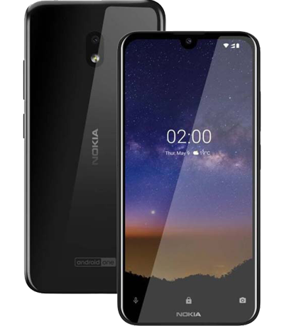
NOKIA 7.2

Slide 18
VOLUME CONTRIBUTOR
Volume Contributor
Most of Nokia 7.2’s volume of this period came from Earned media (92.8%) Earned mentions thanks to dealer thegioididong.com and fptshop.com.vn Customers mostly positive commented on Nokia 7.2 product information about Function, Performance, and Design Link, Link, Link. However, there are still many negative feedback from users about the Battery, Function of Nokia 7.2 Link, Link. The number of volume increased to 4,608 mentions in current period. There is no seeding in this period.

Slide 19
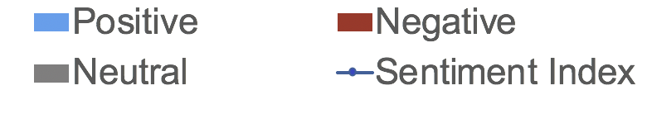
DETAILED SENTIMENT PERFORMANCE
SENTIMENT PERFORMANCE
Neutral sentiment hold the highest rate in this period about 76.7%. Percentage of negative rate was lower than positive about 10.1% and 13.2%, respectively. Customers unsatisfied about Battery or some Function of the phone, while they also satisfied with Function and Performance. There is no seeding in this period. The discussion in this period decreased in this period. Therefore, the sentiment index was lower, with 0.1. There is no discussion from occupied channel Owned media this period.
POSITIVE DRIVERS
Function (28 mentions) Performance (9 mentions) Design (7 mentions)
NEGATIVE DRIVERS
Function (12 mentions) Hardware (9 mentions) Design (5 mentions)
SENTIMENT PERFORMANCE OF NOKIA 7.2 (EXCLUDED SEEDING)
SENTIMENT PERFORMANCE OF NOKIA 7.2 (INCLUDED SEEDING)
SENTIMENT PERFORMANCE OF NOKIA 2.2 (EXCLUDED SEEDING)
SENTIMENT PERFORMANCE OF NOKIA 2.2 (INCLUDED SEEDING)
SENTIMENT PERFORMANCE OF NOKIA 7.2
ON OWNED MEDIA
SENTIMENT PERFORMANCE OF NOKIA .2 ON OUT OF OWNED MEDIA
SENTIMENT PERFORMANCE OF NOKIA 2.2
ON OWNED MEDIA
SENTIMENT PERFORMANCE OF NOKIA 2.2 ON OUT OF OWNED MEDIA
Sentiment ratio bases on the number of remaining mentions after excluding the unrated ones
Sentiment index = (positive index – negative index)/(positive index + negative index)

Slide 20

FEEDBACKS ON PRODUCT ATTRIBUTES
PRODUCT ATTRIBUTES PERFORMANCE
No Data
Period 1
Period 2
Current Period
FOCUS ON POSITIVE DISCUSSED ATTRIBUTES |  | FOCUS ON NEGATIVE DISCUSSED ATTRIBUTES
[Function] Good Camera Verbatim: Nokia 7.2 lấy nét đỉnh ghê huhu - Link (Oct 08, 2019 12:01 PM) Verbatim: Qua trải nghiệm cho thấy : màn hình sắc nét , cảm ứng mượt mà. Về loa thì nghe to và rõ cả loa trong và ngoài riêng tại nghe thì không bằng Sony. Nhận diện khuân mặt và vân tay cũng nhanh khoảng 1-2s thôi. Camera và video thì quá sắc nét luôn video 4k luôn… - Link (Oct 07, 2019 02:56 AM) [Hardware] Good Hardware Verbatim: mình cần màn hình, cam, pin, phần mềm, vậy quá ổn – Link (Oct 05, 2019 09:40 PM) [Design] Good Design Verbatim: Con nokia 7.2 này thiết kế đẹp, nhìn sang trọng, camera sắp xếp cũng tinh tế nữa – Link (Oct 01, 2019 07:08 AM) |  | [Function] Bad Display Verbatim: Sau khi nghe dt.bỏ ra thì màn hình cứ tối thui bấm nguồn cũng mãi mới sáng màn hình. Lỗi vậy là sao ad ơi. – Link (Oct 03, 2019 12:13 AM) [Function] Bad Touch Verbatim: Sao máy mình mới mua mà giờ toàn bị đơ cảm ứng phải tắt đi bật lại mấy lần mới được – Link (Oct 10, 2019 02:58 PM) Verbatim: Cảm ứng màn hình lúc được làm cả không là sao qtv ơi. Tắt màn hình, mở lại lúc đc lúc không, có cuộc gọi đến lại ko quẹt để trả lời đc, ức chế ghê. – Link (Oct 02, 2019 10:11 AM) [Hardware] Bad Battery Verbatim: Mới lâý máy hôm wa sạt đầy 100% lước facebook có 15 phút sao nó tuột hết 14% pin.để độ sáng màng hình 46. Mà máy chưa tải gì quá 5 ứng luôn.zây máy có bình thường k qtv??? Mình có cảm giâc máy hơi đi pin – Link (Oct 07, 2019 08:55 PM)

Slide 21
TOP DISCUSSION BY LOCATION
Period 1
Period 2
Current Period
No Data

Slide 22
SENTIMENT BY LOCATION
Period 1
Period 2
Current Period
No Data
Comment
Comment
The location with the highest positive comments rate is Ha Noi with 70.8%. Most customer focus on the design of the product. Link The location with the highest negative comments rate is Nghe An with 9.5%. Most customer focus on the hardware of the product. Link
Comment
The location with the highest positive comments rate is Da Nang with 89%. Most customer focus on the function of the product. Link The location with the highest negative comments rate is Ho Chi Minh with 5%. Most customer focus on the function of the product. Link

Slide 23
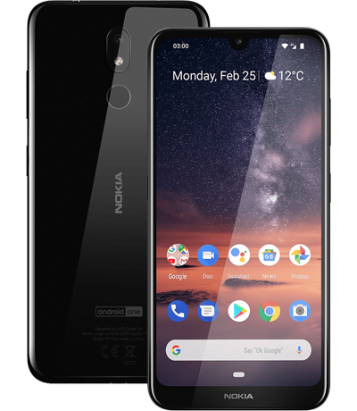
NOKIA 2720 Flip

Slide 24
VOLUME CONTRIBUTOR
Volume Contributor
All of Nokia 2720 Flip’s volume came from Earned media, about 100%. Most of mentions from earned media come from thegioididong.com, fptshop.com.vn There was no post and comment on Owned Media and Paid Media. The mentions earned are mainly about giving feedback on product function and asking for product. Users commented positively about the design and function Link, Link. Function and price are two attribute received most negative feedback Link, Link.

Slide 25
DETAILED SENTIMENT PERFORMANCE
SENTIMENT PERFORMANCE
Neutral sentiment hold the highest rate in this period about 60%. Percentage of negative rate was lower than positive about 16.9% and 23.1%, respectively. The volume of mention from Nokia 2720 have decreased but the sentiment index have changed and increase to 0.2 compared to -0.2 in previous period. There is no seeding in this period. Customers unsatisfied about Function and Price of the phone, while they also satisfied with Function and Performance. There are no media-owned discussions this month.
POSITIVE DRIVERS
Function (8 mentions) Performance (5 mentions) Design (5 mentions)
NEGATIVE DRIVERS
Function (10 mentions) Price (6 mention) Software (2 mentions)
SENTIMENT PERFORMANCE OF NOKIA 2720 Flip (EXCLUDED SEEDING)
SENTIMENT PERFORMANCE OF NOKIA 2720 Flip (INCLUDED SEEDING)
SENTIMENT PERFORMANCE OF NOKIA 2720 Flip ON OWNED MEDIA
SENTIMENT PERFORMANCE OF NOKIA 2720 Flip ON OUT OF OWNED MEDIA
Sentiment ratio bases on the number of remaining mentions after excluding the unrated ones
Sentiment index = (positive index – negative index)/(positive index + negative index)

Slide 26
FEEDBACKS ON PRODUCT ATTRIBUTES
PRODUCT ATTRIBUTES PERFORMANCE
No Data
Period 1
Period 2
Current Period
FOCUS ON POSITIVE DISCUSSED ATTRIBUTES |  | FOCUS ON NEGATIVE DISCUSSED ATTRIBUTES
[Function] Good Voice Call and Contact Verbatim: Con nokia 2720 flip này nghe gọi ok lắm, ba mẹ mình lớn tuổi nghe rõ thích lắm nè – Link (Oct 01, 2019 08:31 AM) Verbatim: Tính năng đồng bộ hóa danh bạ và gmail của nokia 2720 này rất hay – Link (Oct 01, 2019 07:59 AM) [Design] Good Design Verbatim: @traisau_ht máy vậy là nhỏ gọn rùi bác hok có to đâu – Link (Oct 09, 2019 05:00 PM) [Performance] Good Performance Verbatim: Người lớn tuổi không xài smartphone dùng con này quá êm – Link (Oct 01, 2019 07:04 AM) Verbatim: Lâu lắm rồi mới xài lại nắp gập, con nokia 2720 flip này có nhiều tính năng mới hợp thời cũng ngon – Link (Oct 01, 2019 07:04 AM) |  | [Function] Application not available Verbatim: Lâu rồi mới được ngắm Nokia nắp gập mẫu mới .... Đáng tiếc không hỗ trợ Zalo – Link (Oct 04, 2019 10:54 AM) Verbatim: con này chỉ cần: nghe gọi, nhắn tin, đồng bộ danh bạ google và phát wifi bằng 4G là đủ. không cần nhét thêm cả đống (maps, assistant, youtube, game...) vào cho máy nó thêm chậm. Những người mua con này chủ yếu làm máy phụ nghe gọi chứ chẳng ai xài để coi youtube hay lên mạng cả - Link (Oct 03, 2019 04:10 PM) [Price] Too Expensive Verbatim: Giá quá chát. 1tr may ra có người mua – Link (Oct 12, 2019 06:57 PM) Verbatim: Cấu hình tương đương 8110 4G...mà giá hơn 1tr.... Con này tầm 1tr5 mới hợp lý – Link (Oct 07, 2019 10:56 AM)

Slide 27
TOP DISCUSSION BY LOCATION
Period 1
Period 2
Current Period
No Data

Slide 28
SENTIMENT BY LOCATION
Period 1
Period 2
Current Period
No Data
Comment
Comment
The location with the highest positive comments rate is Ho Chi Minh with 55.6%. Most customer focus on the design of the product. Link The location with the highest negative comments rate is Nghe An with 10%. Most customer focus on the price of the product. Link
Comment
The location with the highest positive comments rate is Khanh Hoa with 66.6%. Most customer focus on the function of the product. Link There is no negative comment in top 6 location this period.

Slide 29
NOKIA 8.1

Slide 30
VOLUME CONTRIBUTOR
Volume Contributor
All of Nokia 8.1’s volume came from Earned media, about 100%. Most of mentions from earned media come from thegioididong.com, fptshop.com.vn, cellphones.com.vn There wasn’t any post and comment on Owned Media and Paid Media. The mentions earned are mainly about giving feedback on our update, Android 10. Most of discussions that we collected were almost all Positive, users satisfied with update Android 10. However, there are still negative comments from users about the update with many errors. Link Link Link
No Data

Slide 31
DETAILED SENTIMENT PERFORMANCE
SENTIMENT PERFORMANCE
In the period, Nokia 8.1 has no seeding, negative comments were not improved. So the negative rate is higher than the positive rate. There are no media-owned discussions this period. Negative focus is mainly on updating Android 10 with many errors. Link Link Link
POSITIVE DRIVERS
OS_Upgrade (26 mentions) Function (23 mentions) Performance (9 mentions)
NEGATIVE DRIVERS
Function (60 mentions) OS_Upgrade (32 mentions) Charging (9 mentions)
SENTIMENT PERFORMANCE OF NOKIA 8.1 (EXCLUDED SEEDING)
SENTIMENT PERFORMANCE OF NOKIA 8.1 (INCLUDED SEEDING)
SENTIMENT PERFORMANCE OF NOKIA 8.1
ON OWNED MEDIA
SENTIMENT PERFORMANCE OF NOKIA 8.1 ON OUT OF OWNED MEDIA
Sentiment ratio bases on the number of remaining mentions after excluding the unrated ones
Sentiment index = (positive index – negative index)/(positive index + negative index)

Slide 32
FEEDBACKS ON PRODUCT ATTRIBUTES
PRODUCT ATTRIBUTES PERFORMANCE
No Data
No Data
Period 1
Period 2
Current Period
FOCUS ON POSITIVE DISCUSSED ATTRIBUTES |  | FOCUS ON NEGATIVE DISCUSSED ATTRIBUTES
[Function] Good camera Verbatim: Thích chất ảnh của nokia – Link (Oct 04, 2019 02:47 PM) Verbatim: No8.1 dùng cảm biến của Sony chung với Google Pixel nên khi áp dụng Gcam nó chất hẳn. – Link (Oct 02, 2019 07:38 PM) [OS_Upgrate] Better experience Verbatim: Mình lên update hết thấy dùng nhanh hơn. Cảm nhận chỉ có chút pin giảm hơi nhanh hơn và hiện tại phải dùng bản gg cam cũ – Link (Oct 13, 2019 10:57 AM) [Performance] Good Performance Verbatim: Chip 710 đủ mạnh rồi. Máy xài rất mượt. Pin trâu lắm, xài tới cuối ngày còn hơn 50%. Vân tay rất nhạy. Nói chung đáng đồng tiền. Mấy con máy tầm trung thì cứ Nokia mà quất tới. - Link (Oct 10, 2019 01:17 PM) |  | [Function] Bad Touch Verbatim: Nokia 8.1 nghe đồn bị nhiều lỗi như lỗi cảm ứng, lỗi chân sạc. Với 8.1 đã năm ngoái rồi bạn. – Link (Oct 09, 2019 07:52 PM) Verbatim: NOKIA 8.1. Chán quá các bác ạ. Thi thoảng rè loa trong phải rs mới hết. Giờ thêm cái lỗi màn hình bị nháy kiểu gợn sóng nữa (thi thoảng mới bị và bị nhanh).- Link (Oct 04, 2019 10:52 AM) [OS_Upgrate]: Many errors Verbatime: Có cách nào cho về android 9 ko ạ. Android 10 chán quá, mất nhận diện khuôn mặt, khi vuốt lên toàn hiện 5 ứng dụng vừa sử dụng. Quá thất vọng luôn – Link (Oct 13, 2019 04:42 PM) Verbatime: Sáng nay con Nokia 8.1 của mình vừa cập nhật Android 10 bị nhìu lỗi rồi thật là đầu lòng - Link (Oct 13, 2019 09:12 AM)

Slide 33
TOP DISCUSSION BY LOCATION
Period 1
Period 2
Current Period
No Data
No Data

Slide 34
SENTIMENT BY LOCATION
Period 1
Period 2
Current Period
No Data
No Data
Comment
Comment
Comment
The location with the highest positive comments rate is Da Nang with 90.7%. Most customer focused on update Android 10 of the product. Link The location with the highest negative comments rate is Ha Noi with 13.1%. Most customer focused on errors of update Android 10 of the product. Link

Slide 35
FOCUS ON NOKIA BRAND
Overall sentiment performance of Nokia brand mentions
Attribute performance of Nokia brand mentions

Slide 36
DETAILED SENTIMENT PERFORMANCE
SENTIMENT PERFORMANCE OF NOKIA BRAND (EXCLUDED SEEDING)
SENTIMENT PERFORMANCE OF NOKIA BRAND (INCLUDED SEEDING)
SENTIMENT PERFORMANCE
In this period, there is no seeding so that the negative rate is not improved and higher than the positive rate. Negative rate was 20.9% (decreased 1,1% with previous current) and most of users complain about Function, OS_Upgrate. Link Link Link Positive rate this current was 20.3% (decreased 11,4% with previous current). Most of users happy with feedbacks about Function, good Design and OS_Upgrate Link Link Link
POSITIVE DRIVERS |  | NEGATIVE DRIVERS
Users are excited to Function (good game experience), Good Design and OS_Upgrate (Long time usage battery) |  | Users complain about our Function (bad Security and bad Touch).
Sentiment ratio bases on the number of remaining mentions after excluding the unrated ones
Sentiment index = (positive index – negative index)/(positive index + negative index)

Slide 37
FEEDBACKS ON PRODUCT ATTRIBUTES
PRODUCT ATTRIBUTES PERFORMANCE
Period 1
Period 2
Current Period
FOCUS ON POSITIVE DISCUSSED ATTRIBUTES |  | FOCUS ON NEGATIVE DISCUSSED ATTRIBUTES
[Function] Users are excited to play game Verbatim: Nokia Mobile fix lỗi drop fps rùi ad ạ. Bắn PUBG mượt lắm. Cử chỉ mới vuốt cũng rất mượt 😘😘– Link (Oct 10, 2019 02:25 PM) [Design] Users are satisfied with the design Verbatim: Nokia 6.1+ nhé .. 4tr.. Màn hình 5.8 cũng gần 6' r. Thiết kế đẹp hiệu năng tốt.. Ko có gì phải bàn..– Link (Oct 07, 2019 08:21 PM). Verbatim: Làm máy phụ chơi vui cũng được rồi, máy đẹp quá- Link (Oct 02, 2019 03:59 PM) [OS_Upgrade] Users are satisfied about OS_Upgrade. Verbatim: Nokia Mobile . Cảm ơn Nokia. Do tôi chưa sao lưu nên hệ thống chưa ổn. Hiện tại android 10 hoạt động khá tốt và mượt. Chúc NOKIA thành công !- Link (Oct 12, 2019 09:08 PM) |  | [Function] Users complain about Security Verbatim: Có cách nào cho về android 9 ko ạ. Android 10 chán quá, mất nhận diện khuôn mặt, khi vuốt lên toàn hiện 5 ứng dụng vừa sử dụng. Quá thất vọng luôn– Link (Oct 13, 2019 04:42 PM) Verbatim: Nokia 8.1 lên android 10 cũng bị mất face unlock.– Link (Oct 12, 2019 07:17 PM) [Function] Users complain about Touch Verbatim: Chơi lq cái cử chỉ mới xài khó quá– Link (Oct 11, 2019 05:03 PM) Verbatim: Cảm ứng màn hình lúc được làm cả không là sao qtv ơi. Tắt màn hình, mở lại lúc đc lúc không, có cuộc gọi đến lại ko quẹt để trả lời đc, ức chế ghê.- Link (Oct 02, 2019 10:11 AM)

Slide 38
COMPETITORS OVERVIEW
Key products
Main tactics

Slide 39
HUAWEI NOVA 3I
HIGHLIGHT ACTIVITIES
Most of Huawei's mentions come from on the Huawei Mobile, which content is about sale to users. Link
Sentiment ratio bases on the number of remaining mentions after excluding the unrated ones
Sentiment index = (positive index – negative index)/(positive index + negative index)

Slide 40
SAMSUNG J4
HIGHLIGHT ACTIVITIES
There was not any special activity of Samsung J4. The post contributes to increased interaction of Samsung is on Facebook page Samsung - Link
Sentiment ratio bases on the number of remaining mentions after excluding the unrated ones
Sentiment index = (positive index – negative index)/(positive index + negative index)

Slide 41
APPENDIX
Additional Information

Slide 42
DEMOGRAPHIC
 | Nokia 7.2 | Nokia 2720 Flip | Nokia 8.1 | Nokia Brand
Unique Audience | 1,407 | 131 | 1,324 | 13,450
Gender | Male (47.0%) Female (37.9%) Others (14.9%) | Male (35.7%) Female (41.0%) Others (23.1%) | Male (36.1%) Female (53.1%) Others (10.6%) | Male (54.7%) Female (33.1%) Others (12.1%)
Age | 25–34 (23.0%) 35–44 (76.9%) | 35-44 (50.0%) 45-54 (50.0%) | 18-24 (38.0%) 25-34 (57.1%) 35-44 (4.7%) | 18-24 (19.7%) 25 - 34 (67.1%) 35-44 (10.1%) Above 44 (2.8%)
Location | Ha Noi (11.3%) Ho Chi Minh (10.2%) Da Nang (3.4%) Nghe An (2.9%) Can Tho (2.6%) | Ho Chi Minh (17.9%) Khanh Hoa (5.3%) Ha Noi (3.2%) Binh Duong (3.2%) Tien Giang (2.1%) | Ho Chi Minh (11.9%) Ha Noi (6.7%) Da Nang (3.6%) Quang Ngai (3.0%) Nghe An (2.4%) | Ho Chi Minh (12.2%) Ha Noi (11.1%) Dong Nai (2.3%) Hai Phong (2.0%) Hai Duong (1.9%)

Slide 43
TOP THREADS & SOURCES BY VOLUME OF NOKIA 7.2
TOP THREADS BY VOLUME
NO | THREAD | SOURCE
1 | Bạn sợ điều gì trong những lần “xê dịch” nơi xa? Không máy ảnh xịn ghi nét trải nghiệm? Hay ... | Nokia Mobile
2 | SẮM NGAY NOKIA 7.2 - GIẢM TỚI 490.000đ Nokia đã trở lại và lợi hại hơn xưa! 🌟 Thiết kế nguyên ... | Viễn Thông A
3 | Nokia 7.2 - Chiếc máy với thiết kế hoàn hảo và cứng cáp. Mang lại cho người dùng cảm giác khá ... | Fanpage thegioididong
4 | #vatvofun Công nhận là nó đẹp vl mọi người ạ :)) Nhìn cuốn cực kỳ,tiếc là có mỗi màu đen ... | Vật Vờ Studio
5 | #vatvohoidap Chào mọi người, cho em hỏi: Trong tầm 5-6 triệu, nhu cầu lướt web, xem phim - chụp ... | Vật Vờ Studio
6 | Nokia 7.2 ra mắt thấy rất nhiều fan khác vào chê. Nhất là bọn làm review cho mobile city chê ... | Nokia Fan Club
7 | Mấy ngày này nào là 8.1 lên android 10 nào là nokia 7.2 rần rần còn mình thì lên 1020😊😊😊 | Nokia Fan Club
8 | Đội nhà thi đấu mà giờ giấc trái ngang? Đừng lo! Đã có Nokia 7.2 với màn hình PureDisplay phối ... | Nokia Mobile
9 | #vatvohoidap Xin đánh giá con nokia 7.2 cái ạ Mình theo hướng Chụp nhiều Game vừa Thì ... | Vật Vờ Studio
TOP SOURCES BY VOLUME

Slide 44
TOP THREADS & SOURCES BY VOLUME OF NOKIA 2720
TOP THREADS BY VOLUME
NO | THREAD | SOURCE
1 | Nokia 2720 Flip - Huyền thoại trở lại, hiện đại hơn xưa Đã từ rất lâu rồi, các tín đồ của ... | Nokia Mobile
2 | 2019 RỒI MÀ VẪN LÀM ĐIỆN THOẠI NẮP GẬP??? | AnhEm TV
3 | Màu này yêu hem, video trên tay đủ 3 màu sắc Nokia 7.2 hẹn các bạn mai nha 😋 - Còn đây là ... | Cộng đồng Nokia Lumia Việt Nam
4 | Nokia 2720 Flip, một lần nữa tạo được ấn tượng mạnh khi nó đem lại cảm giác sử dụng sản phẩm ... | Công Nghệ Việt
5 | Màu xám này và xanh là 2 màu đẹp và thời thượng thế mà Nokia Mobile không mang về VN bán sớm, ... | Nokia Fan Club
6 | Thay áo mới, có máy mới thay tiếp nhé anh em, có cái áo mặc hoài từ tuần này qua tuần nọ, từ ... | Cộng đồng Nokia Lumia Việt Nam
7 | Mở hộp Nokia 2720 Flip điện thoại 2 màn hình "cụ tổ" của Galaxy Fold | Dương Dê
8 | Video mở hộp chiếc điện thoại nắp gập 2 màn hình đã lên sóng, mời anh em xem nhé. Mà lạ, đây là ... | Nokia Fan Club
9 | Thông báo cho các bạn là mình đã jailbreak xong con Nokia 2720 Flip và cài được Zalo, Gmail & ... | Nokia Fan Club
TOP SOURCES BY VOLUME

Slide 45
TOP THREADS & SOURCES BY VOLUME OF NOKIA 8.1
TOP THREADS BY VOLUME
NO | THREAD | SOURCE
1 | Không để người dùng Nokia 8.1 đợi lâu 🥰🥰, nay, điện thoại Nokia 8.1 đã được nâng cấp lên ... | Nokia Mobile
2 | Mọi người cho em hỏi, trong số những con điện thoại dưới đây thì con nào có camera tốt nhất? Em ... | Vật Vờ Studio
3 | NOKIA 8.1. Chán quá các bác ạ. Thi thoảng rè loa trong phải rs mới hết. Giờ thêm cái lỗi màn ... | Vật Vờ Studio
4 | Android 10 đã đến với Nokia 8.1 rồi các bác ạ. #vatvofun | Vật Vờ Studio
5 | Nokia quá nhanh quá nguy hiểm 😍😍 #Tinhte #Nokia | Tinh tế Fanpage
6 | Anh em Nokia 8.1 đã lên Android 10 chính thức sau vài hôm trải nghiệm cảm nhận thế nào, mình ... | Nokia Fan Club
7 | Tầm tiền với nhau liệu nên chọn nokia 8.1 hay live ạ. Xin nhận xét công tâm từ anh em đã dùng em nó | Vsmart - Fans Club
8 | Anh em dùng Nokia 8.1 đã lên Android 10 hết chưa nè, nếu chưa thì cập nhật ngay phần mềm mới ... | Nokia Fan Club
9 | Trước và sau khi sài : Google camera .... Nokia 8.1 | Nokia Fan Club
TOP SOURCES BY VOLUME

Slide 46
TOP THREADS & SOURCES BY VOLUME OF NOKIA BRAND
TOP THREADS BY VOLUME
NO | THREAD | SOURCE
1 | Nhìn qua thì Nokia 6300 có vẻ ngon lành ;)) Còn các ông, các ông thích cái nào hơn? :))) #welax ... | WeLax
2 | Nokia N71 Brandnew Fullbox | handheld.com.vn
3 | Đã có một thời Nokia như vầy 😍😍 #Tinhte #NokiaE6 | Tinh tế Fanpage
4 | Đúng cái cảm giá dùng điện thoai "đập đá" hồi xưa của Nokia :D :D #Tinhte #Nokia #800Tough | Tinh tế Fanpage
5 | 2.4 triệu cho một "cục gạch", bạn có mua 🤔🤔🤔 #CellphoneS #Nokia #Nokia800Tough | CellphoneS
6 | Cho đến bây giờ tôi vẫn không biết 2 người này là ai :) #welax #welax_anh #nokia | WeLax
7 | Nhờ màn hình e-ink mà bạn có thể đọc nội dung ngay cả dưới ánh nắng mặt trời, giảm thiểu lượng ... | Tinh tế Fanpage
8 | THỬ THẢ RƠI ĐIỆN THOẠI BỀN NHẤT CỦA NOKIA VÀ CÁI KẾT... | AnhEm TV
9 | Mới đầu tháng thôi mà nhiều khuyến mãi ngon quá trời ⚡️ Fans Nokia còn chờ gì nữa 🥰 | Fanpage thegioididong
TOP SOURCES BY VOLUME

Slide 47
COMMUNITY REPORT

Slide 48
SEEDING CONTRIBUTION
SEEDING CONTRIBUTION
In the period, Nokia was not seeded, negative comments were not improved. So the negative rate is higher. Negative mentions about Nokia 7.2: “Mình muốn đổi đt Nokia 7.2 bị đơ cảm ứng” “lâu lâu mình mở camera máy vào hơi chậm, lâu lâu vào phòng lạnh cảm ứng không ăn nhưng khi mình ra ngoài thì lại bình thường” “Định mua nokia 7.2 mà các bác đánh giá như thế thì thôi vậy, méo mua gì hết. Nokia chụp ảnh thì sai màu, lúc nào chất ảnh cho ra cũng nhợt nhạt hơn màu thực tế. Vẻ ngoài thì đẹp, lễ ra mắt thì đưa chất lượng ảnh chụp lên mây, còn ảnh chụp thực tế thì thôi, tìm mua lumia 1020 cũ vậy.” Negative mentions about Nokia 2720 Flip: “Cảm nhận cầm trên tay Nokia 2720 new của Nokia mới . Quá to , phần mềm chậm , xài chán . Không nên mua” “Nghe nói xài lag lắm :)) mà chạy trên mấy máy như 2720 tức nói chung là k có triển vọng cạnh tranh.” “Cái 2720 này trong phần danh bạ chỉ sử dụng lên xuống không thể tìm tên dễ như các nokia khác. Rất bất tiện. Có cách nào thay đổi việc này không?” Nokia 7.2 and Nokia 2720 Flip are launching so seeding should be maintained regularly to raise positive rate reduce negative information.
Period 1
Period 2
Current Period

Slide 49

Thank
For Your Interest

